Slide 1
Introduction to Programming Using Python

Slide 2
Course Outline (An Estimate)
Course Introduction – Up to here Slide 1
A Very Brief look at Python Language, Programming Environment Slide 10
Course Project – Start Slide 23
First Homework / Introduction Review Slide 29
A General Look at Programming Slide 34
More on Python /Review Slide 41
Notes:
What should the computer do for you?
What should the programming language (Python) do?

Slide 3
Course Outline - continued
More Review of Python Slide 46
Some Programming Exercises Slide 58
Printing, Formatting, … Slide 61
Testing, Loops, … Slide 64
More on program development … Iteration… Slide 70
Functions Slide 83
Notes:
What should the computer do for you?
What should the programming language (Python) do?

Slide 4
Course Outline - continued
Functions – friends… an example Slide 95
Strings Slide 101
Dictionaries Slide 105
Files Slide 106
More Stuff…If possible…
Notes:
What should the computer do for you?
What should the programming language (Python) do?

Slide 5
Instructor – Ray Smith raysmith@alum.mit.edu
Many years of Programming – engineering, scientific, financial
Commercial, Scientific, Systems Languages – C, C++, Perl, Java, Python, Assembly
NEW Areas - Games for young 3-8 years
Notes:
What would you like to know about me?

Slide 6
Objectives
Programming for non-programmers
Demonstrate Operations and Methods
Enable and Energize new programmers
Learning by DOING
Notes:
What do you want from this course?
What do you want from programming?

Slide 7
Our Online Class – Using Zoom
If any background noise, please mute – minimizes cumulative noise
Disable own video – too many reduces clarity
Can question via Chat – can be to ALL
Expecting Response: Start "QUESTION:"
Notes:
What do you want from this course?
What do you want from programming?

Slide 8
Class Session Structure – Each Week
Lecture and practice: 1.5 Hours
Follow-up Questions: .5 Hours
Similar to Programming – This Course
Skips, Repeats / Revisits
Student Guideline:
If you know it – Have Patience
If confused / unsure – ASK QUESTIONS

Slide 9
Session #1 Introduction Touching on the topic
Any questions in general?
Notes:
Who has had any computer programming experience? Python experience?

Slide 10
Programming Telling the Computer What to Do
The language, PYTHON, is a way
Popular, Powerful, and EASY
Like most human languages
You don’t have to know it all to do a lot
Notes:
What should the computer do for you?
What should the programming language (Python) do?

Slide 11
Learn by DOING
Using Python's built in tool IDLE
Integrated Development and Learning Environment
Interactive execution of Python
Python Program editor and execution
Lots of documentation, examples, help
Notes:
Who hasn't downloaded python (from www.python.org)?

Slide 12
Our Sandbox – IDLE Demonstration and Testing
https://www.python.org
Download latest python example: 3.7.0
Python shell
Documentation
IDE - editor, execution, debugger
Notes:
What would you like from a programming tool / helper?
IDLE can provide the environment for us to directly use Python to do things.
What's necessary?

Slide 13
IDLE – continued
Python Documentation:
Help ➔ Python Docs
Help on IDLE:
Help ➔ IDLE Help
Python Program Examples:
Help ➔ Turtle Demo
Notes:
What should IDLE do for you?

Slide 14
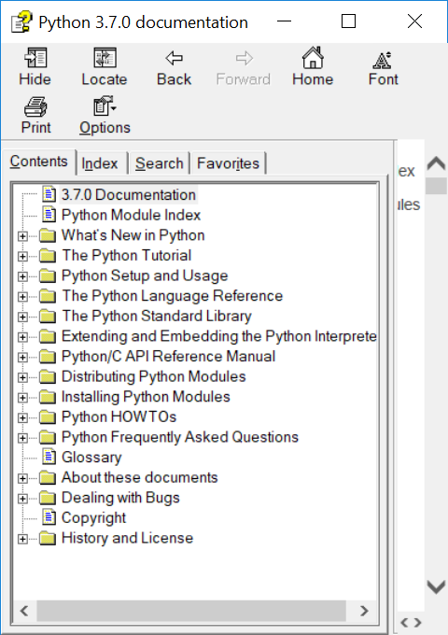
Documentation – Lots of Nice STUFF

Slide 15
A Quick Introduction to Python wordy offline guide file - IDLE
A file with some beginning examples
open python_introduction.txt
File → Open →… exercises → introduction → Text files(*.txt) → python_introduction.txt

Slide 16
Blazing Introduction to Parts of Python
Run Python IDLE
Follow along with instructor
– copy, experiment, question
>>> 1 + 1
2
Saved IDLE Session Example:
exercises\introduction\python_introduction.py
Notes:
Make shortcut?

Slide 17
Blazing Introduction – continued IDLE primer
>>>: IDLE shell prompt (to you the user)
# : start of comment to be ignored
Otherwise: printout from IDLE
>>> 1 + 1 # Comment on 1 + 1
Notes:
Offline self-guide file: exercises/python_introduction.txt

Slide 18
Blazing Introduction Part 1 – Did we mention...
# Beginning comments
1+1, *, /, -, %, **, //, 1+2;3+4, 2+3*4,(2+3)*4
"a", 'b', """c""", '''d''',
"Ray" + " " + "Smith"
print(1, "one", 2, "two")
var_name = 1, a, b
NOT 1a, a b

Slide 19
Blazing Introduction Part 1B – Did we mention...
>>> a
SyntaxError: cannot assign to literal
NameError: name 'a' is not defined
Traceback (most recent call last):
File "<pyshell#7>", line 1, in <module>
Python tries to be helpful
Can't always guess
Tries to be exact
Notes:
What do "assign", "literal", "defined" mean?

Slide 20
IDLE – IF/WHEN I change my mind…
Redo a line by "up arrow" to line
then press ENTER, then make changes
ALT-P(Cth-P on MAC) will "open" last command for changes
After changing code, press ENTER to execute changed command (twice if part of a compound statement)

Slide 21
Blazing Introduction Part 2 Python Code Files
>>> IDLE shell
GREAT for short/simple/one-time testing
NOT SO GREAT for longer/complex/reuse

Slide 22
Blazing Introduction Part 2 Python Code Files
Putting Python code in a file
Fairly easy
Enables reuse
Helps modification

Slide 23
Blazing Introduction Part 2 Python Code Files
Create file File ➔ New File (my_work.py)
… add text (#my_work.py)
File ➔ Save
Maybe in folder “class_work” ???
Reuse - File ➔ Save As ➔ …new name

Slide 24
Blazing Introduction Part 2 - continued Hello World! - You Try!
Write simple program (hello_world.py):
File→New
print("Hello World!")
print("My name is your name.")
Save file – File ➔ Save
OR File->Save As…
Run program – Run ➔ Run Module
Notes:
Howabout: File→File-->Recent Files (select my_work.py)
Then: File→Save As… (hello_world.py)

Slide 25
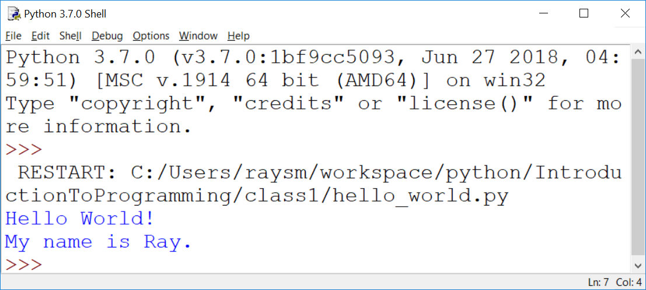
Hello World! – output – my example

Slide 26
Blazing Introduction Part 2 - continued Make a New Program – goodbye_world.py
"Goodbye World…"
Hint - Start with program closest to our goal - hello_world.py (File→Recent Files)
Save As… to new name BEFORE changing
Make changes creating new program
Run new program – Run ➔ Run Module
Notes:
How about goodbye_world.py ?

Slide 27
Blazing Introduction Part 3 – Did we mention...
What so far?
…Arithmetic… Error Messages
if, else, elif, True, False,
a == b, a != b, a > b, a < b, a >= b
while, for, break, continue, range()
input(), int()

Slide 28
Blazing Introduction Part 4 –lists...
list1 = [1,2]
print(list1)
list1.append(4)
print(list1)
for mem in list1:
print(mem)

Slide 29
Blazing Introduction Part 4 – Adding Dictionaries...
d1 = {'name1':1, 'n2':2}
print(d1)
d1['n1b'] = "1a"
print(d1)
for nm in d1:
print(nm, d1[nm])

Slide 30
Course Project A Real Life Program YOU Will Create: Twenty Questions
… I’m thinking of a number …
Your program picks a number
Player guesses
Program tells if higher/lower
Program offers to play again
Notes:
What sort of programs are there? Could there be?
Calculators – financial, industrial
Games

Slide 31
Sample Output
I'm thinking of a number between 1 and 20
Can you guess it? Remember to press the ENTER key
to enter your guess. Good Luck!
Enter Guess:10
Number: 10
Sorry your input of 10 is too high
Enter Guess:5
Number: 5
Congratulations 5 is my number
Play a new game?
Enter N to quit: n
See you next time.
Notes:
Demonstrate: exercises/twenty_questions_dev/iteration_7.py
Have the class play/guess.
What improvements / extensions to this program?
What should we be able to do with programs?

Slide 32
Twenty Questions - continued
Programing → Iteration - improve along the way
Simplification also helps the user
Notes:
What sort of programs are there? Could there be?
Calculators – financial, industrial
Games

Slide 33
Guessing Game – Iteration 1
Create new file named “iteration_1.py”
Do the smallest part
Loop
Ask number, get input
Print number entered
Notes:
What is iteration?
Why iterate?
Why use file name "iteration_1.py"? Our first choices were first.py, second.py, ….
Any problems with iteration?
What's in a game?
goals
interaction
input
output
beginning, middle, end

Slide 34
Guessing Game – Iteration 1 - Hints
Place comments describing task
Use while True:
What variables?
Use string = input("…")
Notes:
You're going to do this.
I'm showing some hints.

Slide 35
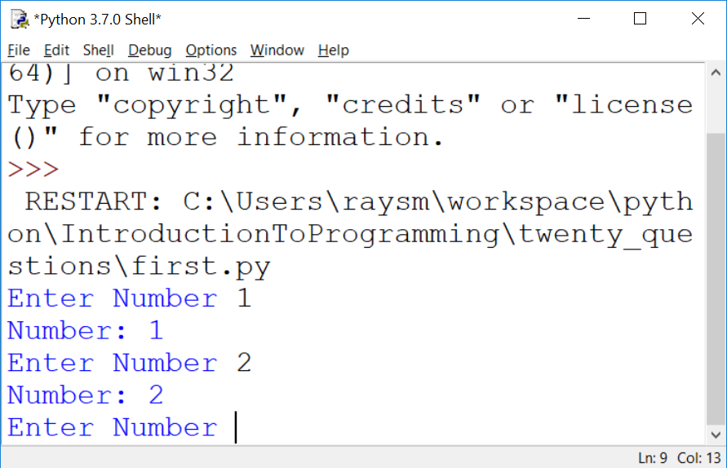
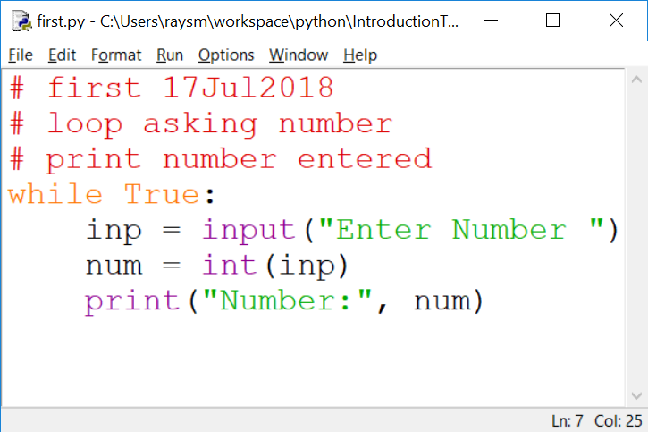
The First Iteration – Code / Output
Notes:
What do we get from doing this iteration?
learning
testing
early fun?
What does it cost us?

Slide 36
HOMEWORK
All ➔ Docs/Introduction to Programming Using Python Homework Exercises.docx
For your benefit / fun
As much / little as you can
Contact me with problems/successes/questions
Have fun!
Notes:
First few lines are just information about this version of IDLE.
Plus, you can always type "help".

Slide 37
Question and Answer
Notes:
Use the previous iteration as a start to the next.
I'll go around and watch.
Raise had if a question.

Slide 38
Session #2 Ideas, Tools, Functions
Any questions in general?
Previous Homework questions?
Who did it? To easy? To hard?
Particular questions on homework
Detailed answers in Q/A half hour session

Slide 39
Programming Ideas – Take a step back
What is programming
Like
Not like
Programming Tools
Creating, Running
Improving through – copy, iteration
Notes:
Most complex activities (reading, skiing, wood work, cooking) – have levels of experties, training, tools

Slide 40
Programming Concepts – Computer == VERY Obedient Servant
Car Example
Most cars are alike
Does what you tell it – hopefully what you want
Same response every time – almost – e.g. forward / backward
Troubles - Car gets the blame…
Notes:
What does a car do for you?
What does a car do that you don't really need / want?
What is the most difficult thing about using a new car?

Slide 41
Similar Activities
Abstract / Indirect
Cooking recipes
Travel directions
Assembly instructions
Physical – What you see is what you get
Construction - Roads, Buildings
Notes:
What's difficult about using recipes, maps, instructions?

Slide 42
Like Computer Programming, They do / have
Build once – use many times
Builder and user(s) often different
Building errors show up many times
Mistakes don't always show up immediately

Slide 43
Unlike Computer Programming, they have / are
Physical materials
Hard to copy
Hard to manipulate
Easy to see

Slide 44
What's Easy to Programming – No so physical
Creation / copying / moving is a snap
Don't wear out
Change easy
Work on new, while using old
Notes:
What makes programming easy/easier than work in the "physical" workplace?

Slide 45
What's Not Easy – because No so physical
Can't "see" it
Everything connected – unexpected consequences
Not easy to tell how close to done
Notes:
What is not so easy in programming?

Slide 46
Python Rules and Mechanics - You will see more Python Details…
What is Python – A Programming Language
Comments
Values – Integer, Float, String
Variables – contain values
Computation / Arithmetic
Rules / Style

Slide 47
Still more Python Tools…
Decisions – if, else
Looping – while, for, break, continue
Grouping – indentation, functions, classes
Functions – parameters, returning
Data Structures – lists, dictionaries

Slide 48
Functions – Divide and Conquer
Group process / plan – e.g. chapters
Each part placed in function
Benefits:
Hide the particulars
Delay consideration
Notes:
One, if not the most, powerful concepts/tools of programming
With almost nothing else one can start programming quite complex things.

Slide 49
Functions – Used
Called - by name, e.g., print()
Data - comma-separated list of values
Result - replaces call
top = max(1,2,3)

Slide 50
Functions – Defined
Definition – Description of plan
Name – same style/restrictions as variable name
Parameters – data passed to the function
Body – What is done

Slide 51
Functions – Parameters
In Call – list of values to use
In Body – List of named values
Parenthesized, comma separated

Slide 52
Functions – Example
def add2(value1, value2):
sum = value1 + value2
return sum
sum1 = add2(1,2) # sum1 gets 1+2
sum2 = add2(3,4) # sum2 gets 3+4
Notes:
Function Calling / Invocation
How do we call the function?
Called with the function name
Including parenthesized list of values
The values are passed to the function

Slide 53
Functions – Exercise – add2.py
Write function to add 2 numbers
Test/exercise it using 1,2; 3,4; 99,100
Notes:
Function Calling / Invocation
How do we call the function?
Called with the function name
Including parenthesized list of values
The values are passed to the function

Slide 54
Functions – Exercise – Homegrown Product Function
product.py
Write a function product(factor1, factor2, factor3)
Returns the product of the values factor1, factor2, factor3.
Test it on the following:
.5, .4, .3; 1, 2, 3; -1, -1, -1;
Notes:
Function Calling / Invocation
How do we call the function?
Called with the function name
Including parenthesized list of values
The values are passed to the function

Slide 55
Functions – Keyword parameters
Optional – for seldom used
Any Order – avoids ordering mistakes
Parameter names help understanding
myfun(key1=2, key2=7)
myfun(key1=4) # default - key2
myfun() # All defaulting
Notes:
Missing or misplaced function arguments are a big problem

Slide 56
Functions – Keyword parameters - continued
def myfun(key1=None, key2=7):
if key1 is None:
key1 = 5 # no key1
return key1 + key2
Notes:
What are the benefits of using None vs explicit value?
None is used to definitely indicate no value was supplied.
In this case – the call was made without the keyword parameter.

Slide 57
Functions – Keyword parameters – example – built-in function: print()
print definition:
def print(*args, end="\n", sep=" ")
print("a", "b", sep=":") #different sep
Print("c","d", end="") #No end line
Exercise: use each print keyword – print_keywords.py

Slide 58
Functions – Keyword parameters – print() Exercise 2: – Print factors – factors_v1.py
Prompt user for n
For numbers 1 to n, print factors
1: 1
2: 1,2 - factors on same line
3: 1, 3
4: 1,2,4
5: 1,5
6: 1,2,3,6

Slide 59
Functions – Keyword parameters – print Exercise
Improvements:
Omit 1, and number itself as factors
Only print numbers with at least one factor other than 1 or itself
Ask from, to

Slide 60
A Quick Review of Python - continued
What is
A string
"here we are"
'there we go'
"It's the way"

Slide 61
A Quick Review of Python - continued
What is
"""
More and
More
"""

Slide 62
A Quick Review of Python - continue
What is
4;5;6
2+3,2*3

Slide 63
A Quick Review of Python - continued
How do we print a value?
On an IDLE line?
Using "print"

Slide 64
A Quick Review of Python - continued
How do we print:
"Hello World!"?
The sum of 1 plus 2?
Three strings "a", "bc", "def"?

Slide 65
A Quick Review of Python - continued
What is a variable?
Of what good is a variable?
Rules for naming a variable?
How do we:
Set up a variable?
Use a variable?

Slide 66
A Quick Review of Python - continued
What does this do:
first = "who"
print(first, "is on first")

Slide 67
A Quick Review of Python - continued
Legal variable names? Why?
a
tom
max_val
A21
target_hi __file__

Slide 68
A Quick Review Python - continued
Illegal variable names? Why?
1a
my name
short-stop
high.val

Slide 69
A Quick Review of Python - continued
Program flow
Decisions to be made
Python decision making keywords?
How is keyword used?

Slide 70
A Quick Review of Python - continued
Write a test that prints "a" if a is greater than b. Do we need something first?
Write a test that prints "a" if a is greater than b and "b" if not. Do we need something first?
Notes:
Variables need initialization before they may be used.

Slide 71
A Quick Review of Python - continued
Program Exercises
Write a loop that prints the numbers from 1 to 10.
Write a loop that prints the odd numbers from 1 to 9.
Notes:
Variables need initialization before they may be used.

Slide 72
Python Language - continued
Arithmetic almost like algebra class : +,-,*, >, >=, ==
BUT single “=” is for assignment
max_value = 20
value = value + 5
in = pr * (1+rate)**years

Slide 73
Python Language – print function
Prints one or more values
Separate values by commas (,)
print("Hello")
print("value: ", 10)
print("Maximum: ", max)

Slide 74
Python Language - Testing
if condition :
One or more indented lines
if value > max_value:
print("value", value, " is big")
print("Try less than", max_value)

Slide 75
Python Language – Looping - while
while condition :
One or more statements indented
to the SAME indentation
while value < max_value:
print("value ", value, " is OK")
value = value + 10
print("value is now", value)
Notes:
Why loops?
What should a loop have / do?

Slide 76
Python Language – Looping - for
for variable in list “:”
One or more statements indented
to the SAME indentation
while value < max_value:
print("value ", value, " is OK")
value = value + 10
print("value is now", value)
Notes:
Why loops?
What should a loop have / do?

Slide 77
Exercise: “Times Tables” for 13 – 1x13, 2x13, …,13x13
Hints:
Create new file named “timestable.py”
Setup: name and set variables – nval = 13 first =1 last = nval n = first
Loop: while n <= last:
print(n, "x", nval, "=", n * nval)

Slide 78
Python Language – input function
Get user input
inp = input()
Prompt user first
inp = input("Please enter:")
Convert to Integer
nval = int(inp)
Notes:
Accepting input and dealing with it makes programs much more powerful than calculators or Television.

Slide 79
Exercise: “Times Tables” – with user giving number
Hints:
Use “timestable.py” as start
New file name = “timestableN.py”
Replace “13” with variable “nval”
Use inp = input("Enter mult:")
Use nval = int(inp)
Notes:
Why a NEW file name?
When do we create it?
WHY?

Slide 80
Exercise for LATER: “Times Tables” – Full table from 1x1 to NxN
Hints:
timestableN.py → timestableNbyN.py
How to do it by hand?
How many loops?
What are the variables?
Notes:
What are the issues?
What's the most difficult thing to achieve.

Slide 81
Second Iteration – A bit More
Set target value
Quit if number entered number equals target
Hints:
Start from first.py
Use break to quit while loop
Notes:
Why use File→Save As ("iteration_2.py") BEFORE any changes or additions?
HINT: What happens if, after one does a lot of additions, one does File→Save ?
What happens to the original "first.py" file contents?

Slide 82
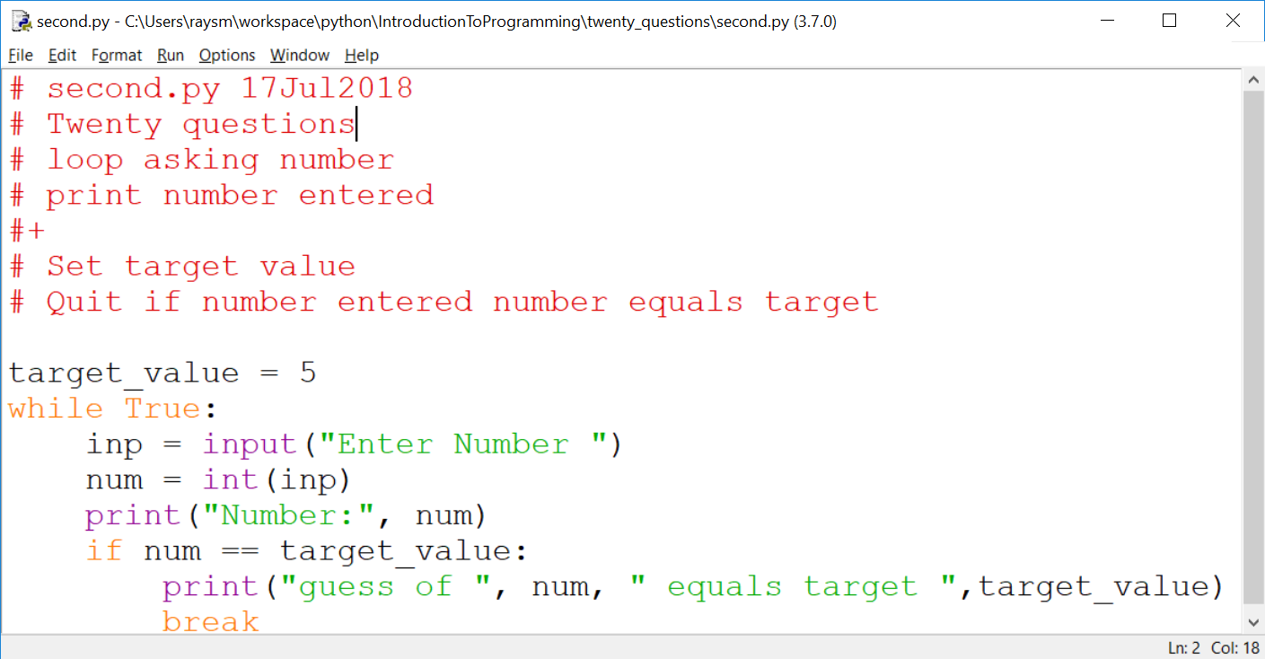
Second Iteration – continued
Notes:
NOTE: Our solution files are in exercises/twenty_questions_dev/iteration_1.py,…

Slide 83
Thinking of Iterations - Show progress
Think Features
Prioritize
Order most to least / easy to hard
Build to the next
Balance Big Bang! with Show it NOW.
Show progress
Notes:
What is(are) the simplest idea(s)
Before anything else what does the program do?
What's the next?
Progress is good for YOU too!

Slide 84
Sample Program Iterations
First:
loop asking number
print number entered
Second:
Set target value
Quit if number entered number equals target

Slide 85
Think of the Iterations - continued
Third: Say if greater, less or equal
Fourth: Set target to random number
Fifth: Say goals, rules before start, including "a number between…"
Sixth: Ask player if they want another game – play multiple times
Seventh:

Slide 86
More Python – Variables Places to store values
Holds data, with a name
Eases the use/reuse our data/results
Names have rules:
Start with a letter (a-zA-Z_)
Followed by zero or more digits (0-9) or letters
OK - a, a1, my_variable, a2or3
NOT - 1, 1a, my-variable, "ray,smith"
Notes:
Why variables?
What are the issues with variables?

Slide 87
Python Language Guidelines with some exceptions
A statement is on ONE line
YES:
sum = 1 + 2
NO:
sum = 1 +
2
Parenthesized grouping may be on multiple lines
YES: sum = (1
+ 2)
Notes:
Note any place that has parentheses allows multi-line / indentation free formatting. Examples: arithmetic (….), print(….), and other functions.

Slide 88
Python Language Guidelines - continued
A group of statements:
Are executed in order
Must start at same indentation (from left)
BUT Parenthesized: ( ),[ ],{ } groupings may have any indentation within the parentheses
Notes:
Don't mix spaces and tabs
Stick with spaces
Editor can help

Slide 89
Python Language Guidelines - continued
YES:
start = 1
last = 3
increment = 1
NO:
start = 1
last = 3
increment = 1

Slide 90
Python import Bring in support
import brings in support
import random # for random numbers
from random import randint # just named
Internet Examples
Often include import statements
Sometimes forget
Notes:
Where do we find examples?
Internet
Documentation
Tutorials

Slide 91
Help is a click away Web searching
Try "python thingies …"
E.g. python random int between two numbers
Found: python - Generate random integers between 0 and 9 - Stack Overflow
GOT:
Try:
from random import randint
print(randint(0, 9))

Slide 92
Help is a click away Web searching - continued
Be brief – search algorithms are pretty good
First code may be wrong.
Someone saying Did this … didn't work
Stackoverflow.com
Question…
Answer…
Checkmark – Best liked answer
Answer…
Notes:
Internet is like a bunch of varied friends
Often correct but sometimes on a different track

Slide 93
Question and Answer
Notes:
Use the previous iteration as a start to the next.
I'll go around and watch.
Raise had if a question.

Slide 94
Session #3 Functions – Why and How
Any Questions?
Previous Homework questions?
Who did it? To easy? To hard?
Particular questions on homework
Detailed in Q/A half hour session

Slide 95
Functions – An example of use friends_family/friends_1.py
Assume a database or game or organization which includes friends
Needs utilities / worker functions
Add friends, list friends, check if one is a friend, …
Build up – friends_family/ friends_1.py, …

Slide 96
Lists – a review
Ordered group of values
friends = ["tom", "dick", "jane"]
Access by position, starting at 0
print("1st:", friends[0], " 3d:",
friends[2])
Add to end
friends.append("joe")
Notes:
First element at index: 0
Last element at index: len()-1
What sort of information would fit into a list?

Slide 97
Lists – more review
Loop (iterate) through list – colors.py
colors = ["red", "orange", "yellow",
"green", "blue", "indigo",
"violet"]
for color in colors:
print(color)

Slide 98
Friends – Simple List Example / Exercise
list_friends.py – just print a list of friend names
my_friends = ["ray", "sue", "joe"]
for name in my_friends:
print(name)

Slide 99
Exercise: add to list – add_friends.py
Short list of friend names
Loop:
Prompt "Enter name[print all]
If "" – print whole list
Else – add input to list

Slide 100
Functions – friends_1.py
First start
A function to list friends
A function to add a friend
A "test" to help verify our work
Notes:
Why write "list friends" BEFORE "add friends"?
Hint: How do we test?

Slide 101
Functions – friends_2.py
Improving – adding to friends_1.py
add_friends – multiple friends
test_add_friends – test new functionality

Slide 102
Functions – friends_3.py
Improving
is_friend – checking if friend
test_is_friend – test new functionality

Slide 103
Functions – friends_mod.py
Facilitate built-in test
if __name__ == "__main__":
print("Self test", __file__)
test_add_one_friend()
test_add_friends()
test_is_friend()

Slide 104
Functions – friends_4.py
Code in friends_mod.py, facilitating reuse
from friends_mod import *

Slide 105
Strings - Like a lists of characters - ALMOST
Assigned as a group, not via index
str_name = "abcdef"
NOT str_name[0] = "a"
Can be Accessed by index
if str_name[1] == "b":
print("Yep it’s the second character")
Notes:
What sort of information would fit into a string?

Slide 106
Strings - continued
Strings can't be changed in place (immutable)
But += works
name += last_name
Because x += y defined as x = x + y
name = name + last_name
Notes:
Not modifiable == immutable
Don't change – replace - a = (do stuff with a or parts of a)

Slide 107
Strings – continued - immutable
Not modifiable == immutable
Don't change – replace
str_name = "a" + str_name[1:]
Notes:
Not modifiable == immutable
Don't change – replace - a = (do stuff with a or parts of a)

Slide 108
Question and Answer
Notes:
Use the previous iteration as a start to the next.
I'll go around and watch.
Raise had if a question.

Slide 109
Session #4 Classes and More
Any Questions?
Previous Homework questions?
Did it? Too easy? Hard?
Particular questions
Extended -- in Q/A half hour session
Notes:
Use the previous iteration as a start to the next.
I'll go around and watch.
Raise had if a question.

Slide 110
Dictionary - Group of values - Access by key
trades_d = {
"painter" : "tom",
"landscaper" : "joe",
"plumber" : "kate"
}
print("landscaper:", trades_d["landscaper"])
Notes:
The key may be a name string, descriptor string, value
What sort of information would fit into a dictionary?

Slide 111
Dictionary - continued
for trade in trades_d:
print(trade, trades_d[trade])
for tra, who in trades_d.items():
print(tra, who)
trades_d["programmer"] = "ray"
if "painter" in trades_d:
print("We have a painter")
Notes:
.

Slide 112
Using Dictionary as command list
commands = {"up":1, "down":1, "left":1, "right":1}
for inp in ["up", "down", "in", "out"]:
if inp in commands:
print("Do cmd:", inp)
else:
print("input:", inp, "not in:", commands)
Notes:
A "dictionary" with only keys (no values) is a set.

Slide 113
Command list Exercise
commands_redo_1.py → commands_redo_2.py
commands = {"up":1, "down":1, "left":1, "right":1}
for inp in ["up", "down", "in", "out"]:
Put in the checks for command in list/out of list
Notes:
A "dictionary" with only keys (no values) is a set.

Slide 114
Simple command example
Exercises/dictionarys/motion.py
Notes:
A "dictionary" with only keys (no values) is a set.
What improvements could you make? In input? In motion? In goals?

Slide 115
Classes – Programmer Defined Objects
Complex data types
Person: name, home_address, work_address
Address: number, street, state
Complex Activity /Organization
AirPort: name, address, runways
Runway: length, width, location, direction
Notes:
Can the students provide examples?
Data types
Activity/Organization

Slide 116
Classes – Structure – Object Oriented
Group data and function
Data – object's state
Function – object's actions

Slide 117
Classes – In action
Create object:
obj = ClassName(values…)
Use object:
obj.list() # list object
obj.add(obj2) # add obj2 to object

Slide 118
Classes – definition
Definition - member functions:
Predefined functions
def __init__(self,…): - initialize data
def __str__(self,…): - used show as string
User defined functions
def my_names(self,…): –do my object's actions
Notes:
"__" leading, and sometimes trailing, double underscore "dunder" – informally reserved for special type variable or function names

Slide 119
Classes – definition
Definition:
class Person:
def __init__(self,
name,
is_friend=False,
is_family=False,
address=None):
… setup person …

Slide 120
Classes – Example: Person
Person person_classes/person.py Class Person
Person's information
Person's setup / initialization
Person's actions

Slide 121
Classes – Example: PersonGroup
exercises/person_classes/person.py
Generalizing previously mentioned friends_family

Slide 122
Classes – Example Class PersonGroup
Class PersonGroup, in file person_group.py
Group's information
Group's setup / initialization
Group's actions e.g. list, add, test for membership

Slide 123
Classes – Example Class PersonGroup
exercises/person_classes/person_group.py

Slide 124
Session #5 Files
Any Questions?
Previous Homework questions?
Did it? Too easy? Hard?
Particular questions
Extended -- in Q/A half hour session
Notes:
Use the previous iteration as a start to the next.
I'll go around and watch.
Raise had if a question.

Slide 125
Files Data that stays around
Stream of bytes/characters "on disk"
Has a File Name
Open File – Create, if new
Read / Write sequentially
Close File
Notes:
File, as a named group of bytes is an abstraction.
Years ago the programmer needed to understand more about the structure.
Your Python program is a data file to some program(s).

Slide 126
Files – continued – Creating
Be careful with names- don't overwrite
#create_file.py
with open("my.txt", "a") as fout:
for i in range(1,5):
print("line %d" % i, file=fout)
Notes:
Open modes "r" –read, "w" – write, "a" - append

Slide 127
Files - continued
# read_file.py
file_name = "my.txt"
with open(file_name) as finp:
for line in finp:
print(line, end="")
Notes:
Note: print adds a newline at the end by default.
To avoid this, use the end="" parameter to replace the default newline with "".
e.g.

Slide 128
Files – continued – Exercises
Create your own two examples
1. create_file.py - Write and check
Save as read_file.py
2. read_file.py – Modify to do reading…
Notes:
What are the benefits of save / modify approach?
What are the pitfalls?

Slide 129
Files – continued Notes - A Simple Data Base
Goal:
Access to my data by name
Plan:
Save data in a text file
Search all lines for patterns e.g. name
Print lines where found

Slide 130
Notes - A Simple Data Base – Continued Details
Create two test files
test.notes – real short just a couple of lines
Joe Name Joe Smith
Joe Address 100 Main
Sam Name Sam Jones
Sam Address 20 Center
Watertown.notes – longer with more varied data

Slide 131
Notes - A Simple Data Base – Continued Details
Make "notes.py" program file.
Will display lines from a text file
that contain a given text string.

Slide 132
Notes - A Simple Data Base – Continued Iterations
1. Read specific file e.g. "test.notes"
print out all lines
2. Print only lines containing "student"
How to match lines ?
2.a Match (Student, STUDENT)
3. Prompt for, then accept file name, pattern
4. [Extra Credit] Multiple text patterns

Slide 133
Future – Python as "Glue"
Python can run other programs
E.g. notepad.exe
import subprocess as sp
fname = "notes.py"
sp.Popen(["notepad.exe", fname])

Slide 134
Python Language – print function - more
Inserting variables/values –
Formatted string (f-strings)
v_str = "string value"
v_int = 123
print(f"this has v_str={v_str}") print(f"this has v_int={v_int}")

Slide 135
Python Language – formatted string in action
>>> v_str = "string value"
>>> v_int = 123
>>> print(f"this has v_str={v_str}")
this has v_str=string value
>>> print(f"this has v_int={v_int}")
this has v_int=123
>>>

Slide 136
F-string – easer / more powerful string formatting
building print strings
Put "f" before first quote
Place variable inside "{}"
t_nm = "Tom"
m_nm = "Mary"
print(f"tom={t_nm} mary={m_nm}")
Notes:
.

Slide 137
F-string – continued
{variable/expression:formatting}
:5d – integer 5 places
:5.2 – float 5 places, 2 dec pt
:>5 – string 5 places right justified
Notes:
.

Slide 138
F-string – continued
runners = { "tom" : { "count" : 5,
"time" : 3.8
},
"joe" : { "count" : 7,
"time" : 5.728
},
"mary" : { "count" : 10,
"time" : 7.62
}
}
Notes:
.

Slide 139
F-string – continued
# Print Heading
print(f"{'name':10}"
+ f" {'count':5}{'time':>5}")
for rname in runners:
info = runners[rname]
print(f"{rname:10} {info['count']:5d}"
+ f" {info['time']:5.3f}")
Notes:
.

Slide 140
F-string – continued
Output:
name count time
tom 5 3.800
joe 7 5.728
mary 10 7.620
Notes:
.

Slide 141
Finding python.exe from IDLE
Python 3.7.0 (v3.7.0:1bf9cc5093, Jun 27 2018, 04:59:51) [MSC v.1914 64 bit (AMD64)] on win32
Type "copyright", "credits" or "license()" for more information.
>>> import sys
>>> print(sys.executable)
C:\Users\raysm\AppData\Local\Programs\Python\Python37\pythonw.exe
>>>

Slide 142
Other Python Teachings
Beginner
Beej's Guide to Python Programming For Beginners
https://beej.us/guide/bgpython/html/
W3Schools Online Web Tutorials
https://www.w3schools.com/python/default.asp
Simple python/programming introduction (Note uses python 2.x)
https://www.slideshare.net/EdurekaIN/python-ppt?next_slideshow=1
More Experienced Programmers
The Python Tutorial
Run IDLE ➔ Help ➔ The Python Tutorial

